Slide 1
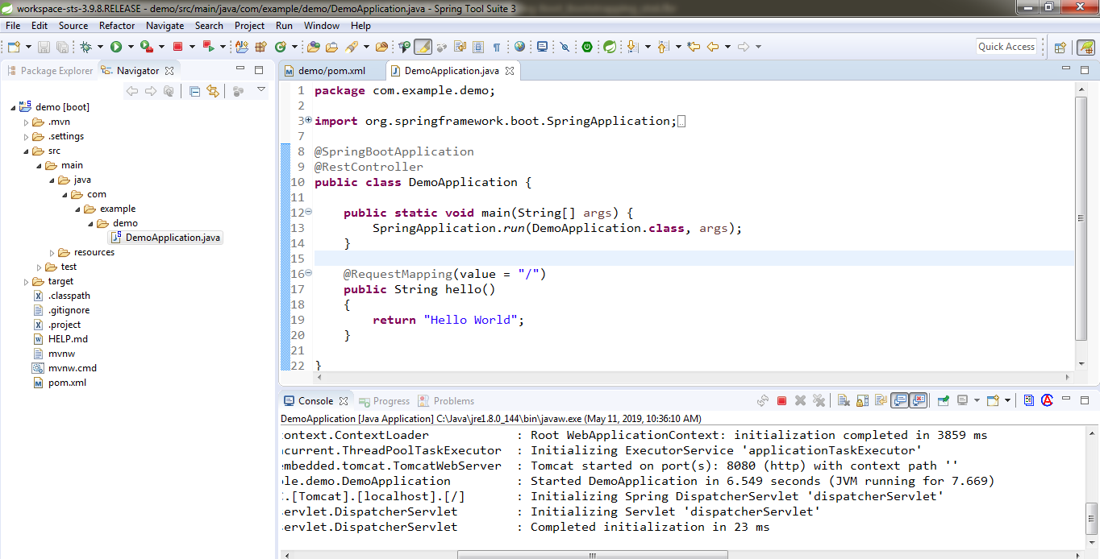
How to Create Spring Boot Project in STS?
https://spring.io/tools3/sts/all

